Slide 1
Classification

Slide 2
Review
Features
Labels
Train/test split
Normalization
Parameters (weights)
Loss
Input (x)
Output (y)
Model
Data
Data
Input
Model
Output
x
f(x)
y

Slide 3
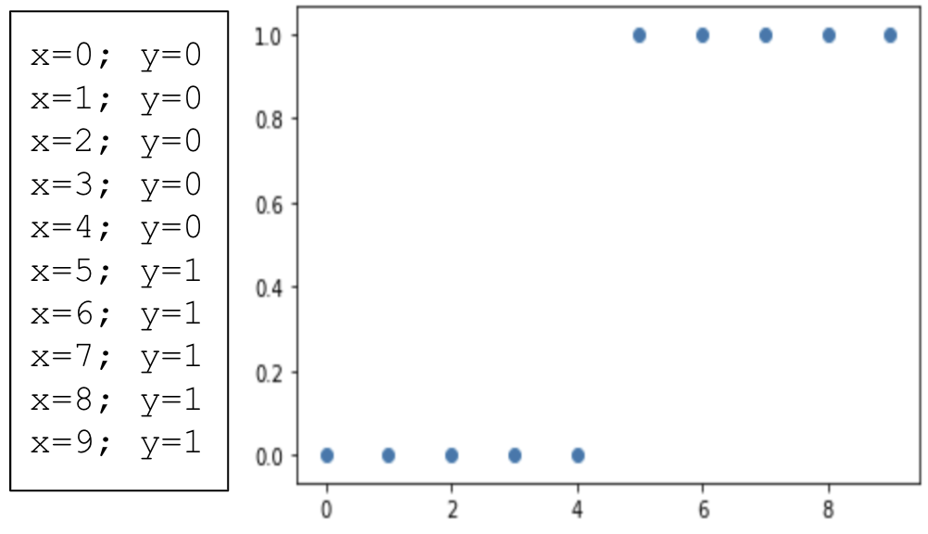
Classification
Could we model this data with linear regression?

Slide 4
Classification
Could we model this data with linear regression?
Does it make sense?

Slide 5
Classification
Could we model this data with linear regression?
Does it make sense?
Binary Classification: labels are in {0,1}

Slide 6

Classification Examples
Spam classification

Slide 7

Classification Examples
Spam classification
Fraudulent transactions

Slide 8
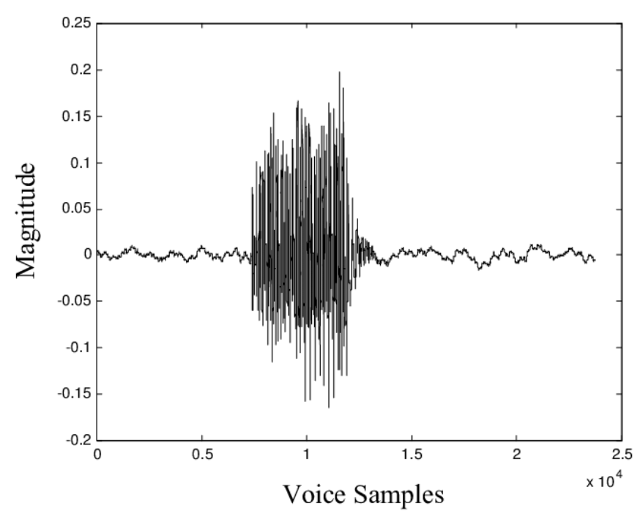
Classification Examples
Spam classification
Fraudulent transactions
Speaker identification

Slide 9
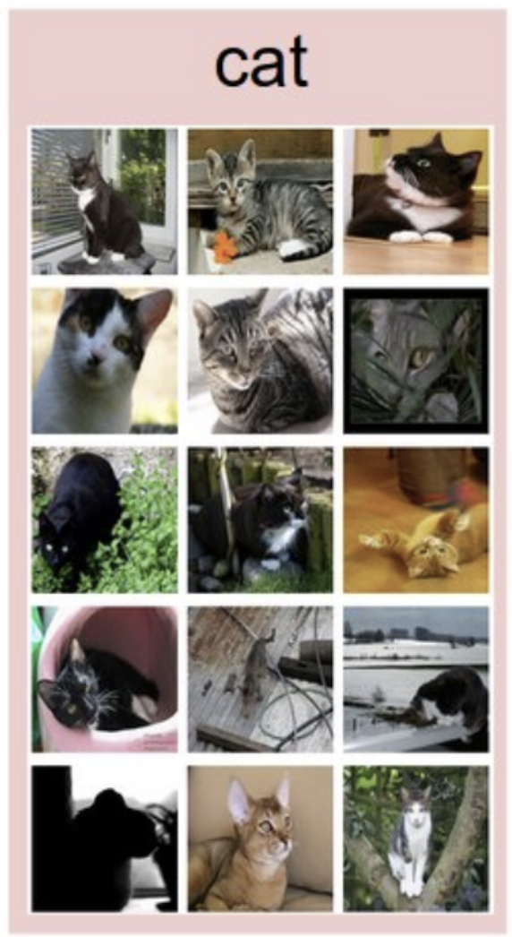
Classification Examples
Spam classification
Fraudulent transactions
Speaker identification
Cat detection

Slide 10
Classification
Notes:
Q: [True/False] Linear regression cannot be applied to binary-valued labels.
A: False

Slide 11
The Logistic Function

Slide 12
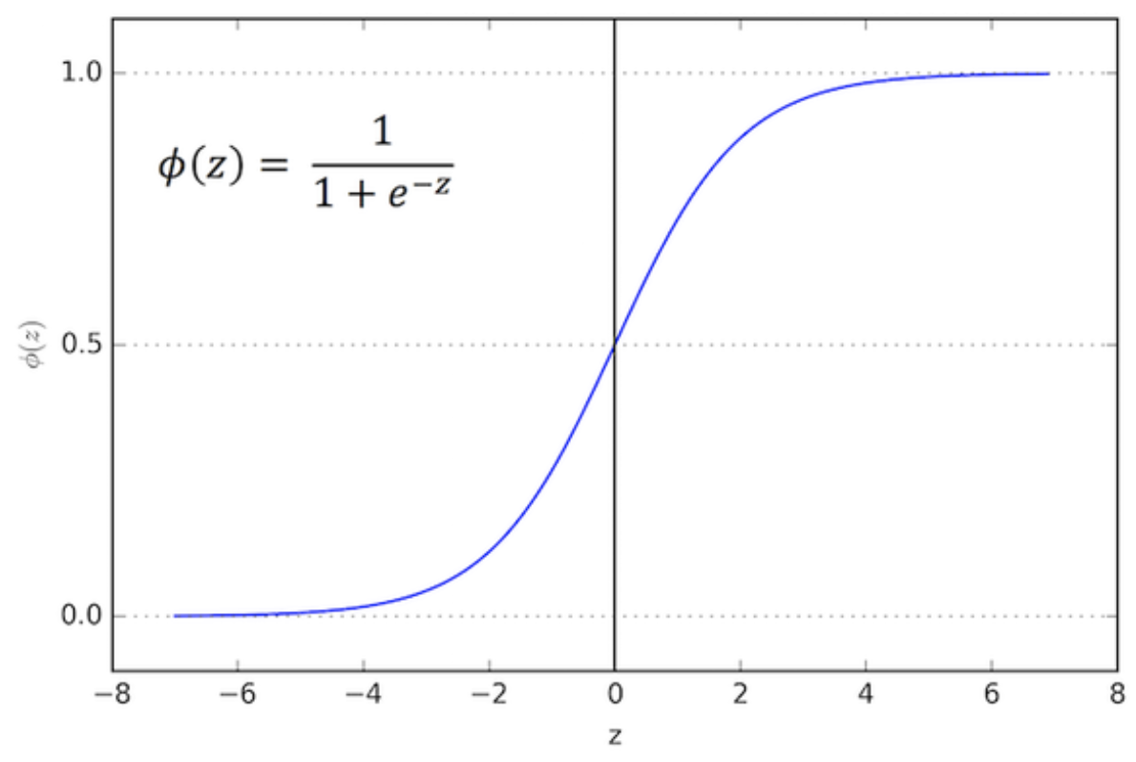
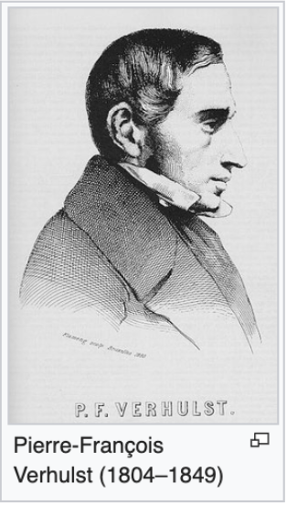
Logistic Function
Also, sigmoid function
Notes:
evolution of populations

Slide 13
Logistic Function
Also, sigmoid function
Range for x?

Slide 14
Logistic Function
Also, sigmoid function
Range for x?
Range for y?

Slide 15
Logistic Function
Also, sigmoid function
Range for x?
Range for y?
Scales to the range of probabilities

Slide 16
Applied to Binary Classification
Notes:
here’s our example from before

Slide 17
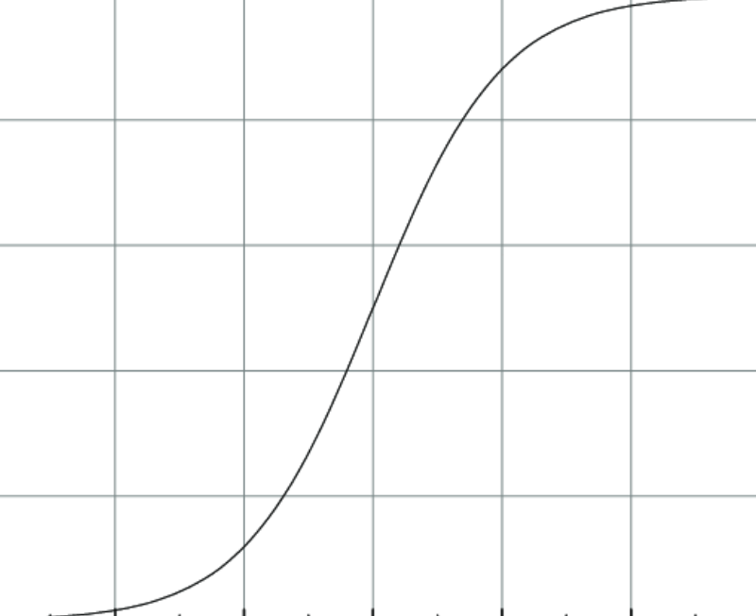
Applied to Binary Classification
Notes:
fit a logistic curve to the data
[LR controls midpoint and steepness of this fit]

Slide 18
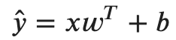
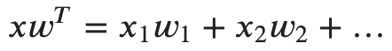
Functional Form
Linear Regression
Recall:

Slide 19
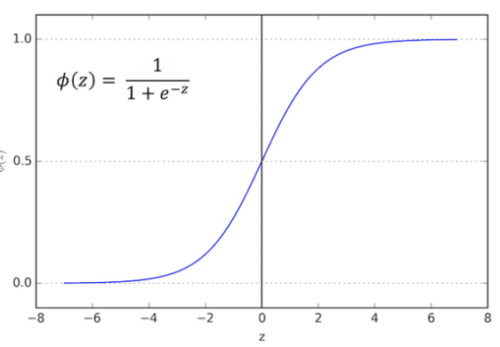
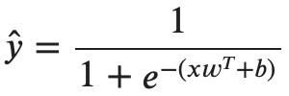
Functional Form
Linear Regression
Logistic Regression
Recall:
Notes:
write as \sigma(xw^T+b)

Slide 20
Functional Form
Linear Regression
Logistic Regression
Apply a sigmoid to the linear regression model
Recall:

Slide 21
Functional Form
Linear Regression
Logistic Regression
Apply a sigmoid to the linear regression model
Midpoint
Steepness
Recall:

Slide 22
The Logistic Function
Notes:
Q: [True/False] The logistic function maps any real-valued number to the probability scale.
A: True

Slide 23
Classification Example

Slide 24
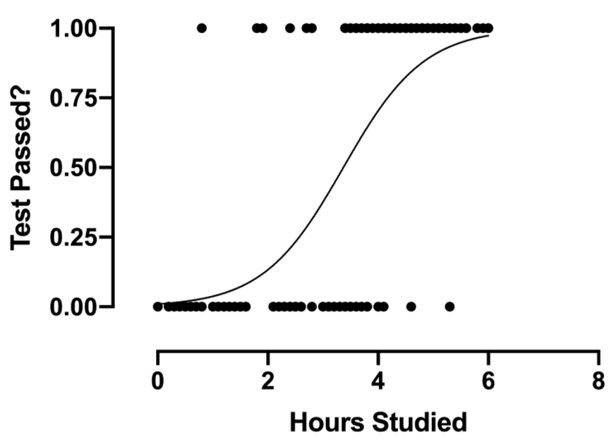
Passing Grade Classifier

Slide 25
Passing Grade Classifier
Model parameters: b=-3; w=1

Slide 26
Passing Grade Classifier
Model parameters: b=-3; w=1
What does the model predict for studying for:
0 hours
2 hours
4 hours
8 hours
Notes:
0: 0.047
2: 0.269
4: 0.731
8: 0.993

Slide 27
Classification Example
Notes:
Q: In the example, how many hours of studying yields a predicted passing rate of exactly 0.5?
A: 3

Slide 28
The Decision Boundary

Slide 29
Classification Threshold
Logistic regression predicts a probability
Notes:
[draw sigmoid again]

Slide 30
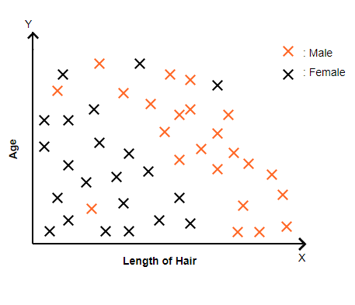
Classification Threshold
Logistic regression predicts a probability
Notes:
the label y is not plotted on a 3rd axis, but with a color
in this data, the males tend to have longer hair
let’s say this is our test data

Slide 31
Classification Threshold
Logistic regression predicts a probability
Use a threshold to get a label
y’ >= 0.5 -> class 1
y’ < 0.5 -> class 0
Notes:
once you have a threshold, your model implies a decision boundary

Slide 32
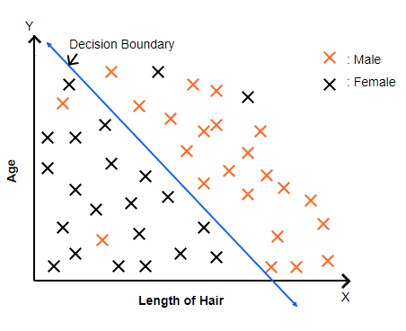
Classification Threshold
Logistic regression predicts a probability
Use a threshold to get a label
y’ >= 0.5 -> class 1
y’ < 0.5 -> class 0
Accuracy = correct / total
[source]

Slide 33
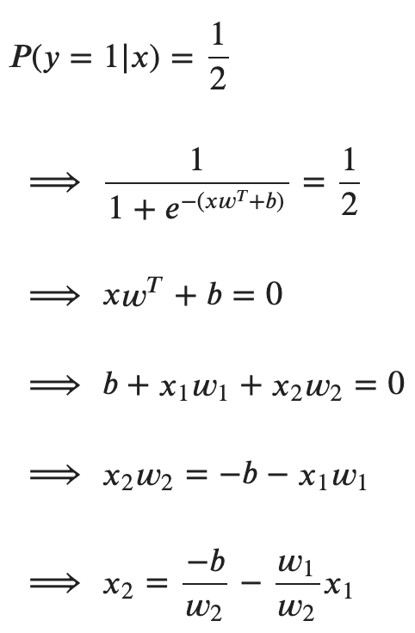
Decision Boundary
Notes:
the decision boundary is the set of inputs where the predicted probability is exactly 0.5
so what values of (x1, x2) produce predictions of 0.5 given the model parameters?

Slide 34
The Decision Boundary
Notes:
Q: [True/False] For a given model, different values of the classification threshold will always produce the same accuracy.
A: False

Slide 35
Logistic Loss

Slide 36
Differentiable Loss
Can we use accuracy as our loss function?
[source]
Notes:
[draw 0-1 loss function]

Slide 37
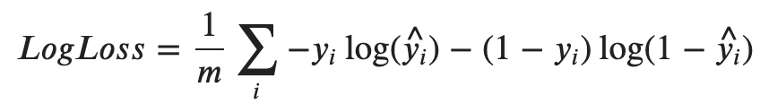
Logistic Loss

Slide 38
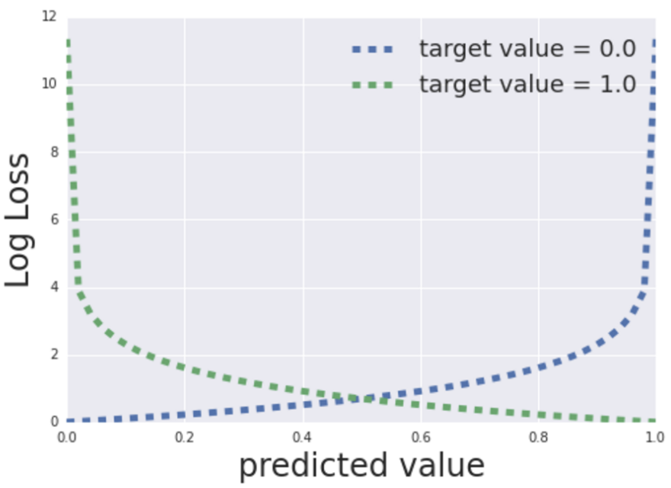
Logistic Loss

Slide 39
Logistic Loss
Example: y=1, y’=.25

Slide 40
Logistic Loss
Example: y=1, y’=.25
loss = -1*log(.25) - (1-1)*log(1-.25)
= -log(.25)
=~ 1.39

Slide 41
Logistic Loss
Example: y=1, y’=.25
loss = -1*log(.25) - (1-1)*log(1-.25)
= -log(.25)
=~ 1.39
Example: y=0, y’=0.25

Slide 42
Logistic Loss
Example: y=1, y’=.25
loss = -1*log(.25) - (1-1)*log(1-.25)
= -log(.25)
=~ 1.39
Example: y=0, y’=0.25
loss = 0*log(.25) - (1-0)*log(1-.25)
= -log(.75)
=~ 0.29

Slide 43
Logistic Loss
Notes:
Q: [True/False] Log loss is undefined when |y-y’|=1
A: True

Slide 44
Gradient Descent with Log Loss

Slide 45
Gradient Descent
Log loss is differentiable

Slide 46
Gradient Descent
Log loss is differentiable
and convex

Slide 47
Gradient Descent
Log loss is differentiable
and convex
and the gradient computation is exactly the same as linear regression with squared error loss

Slide 48
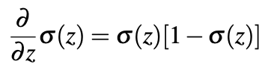
Gradient Descent
derivative of sigmoid
Notes:
[draw sigmoid and derivative]
[derivative max at 0, 0.25]

Slide 49
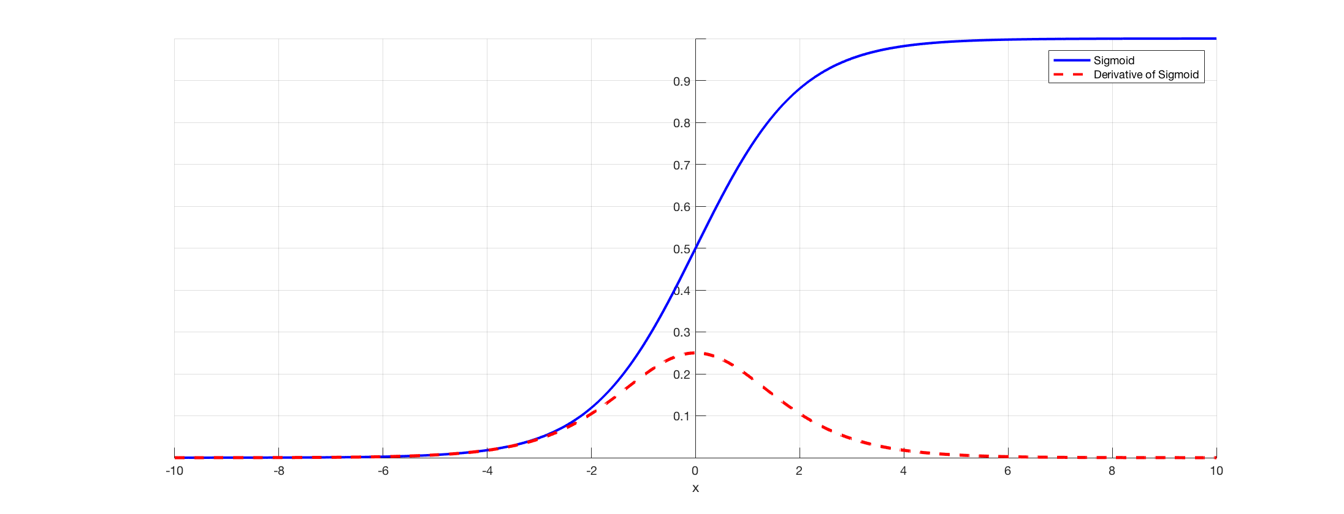
Gradient Descent
derivative of sigmoid
Notes:
[draw sigmoid and derivative]
[derivative max at 0, 0.25]

Slide 50
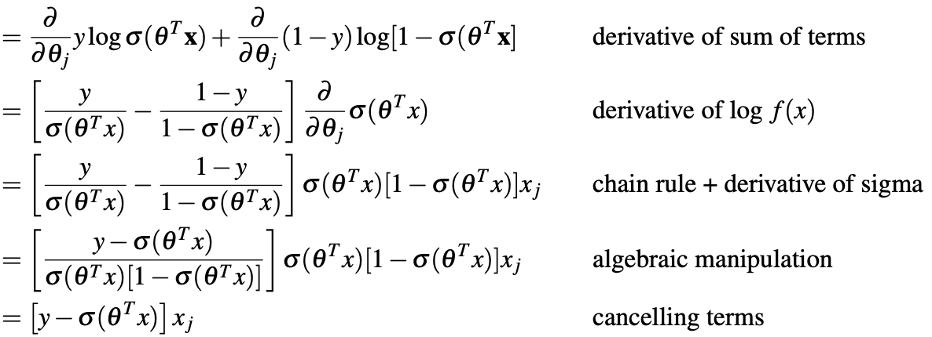
Gradient Descent
derivative of sigmoid
Notes:
start with: d/dw_j J =

Slide 51
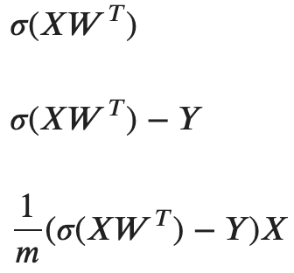
Gradient Descent
Predictions
Differences
Gradient
Notes:
X is [m,n]
W is [n,1]
Gradient: [1,m][m,n]

Slide 52
Gradient Descent
Initial model?
Notes:
1/(1+e^(-xw+b))
[horizontal line at y=0.5]

Slide 53
Gradient Descent
Initial model?
Gradient step?

Slide 54
Gradient Descent
Initial model?
Gradient step?
Convergence?

Slide 55
Gradient Descent with Log Loss
Notes:
Q: From memory, write down the functional form for logistic regression in terms of y, x, and the parameters W and b.
A: y = 1/(1+e^-(xW+b))

